Slide 1
Camel Up
Final Project

Slide 2
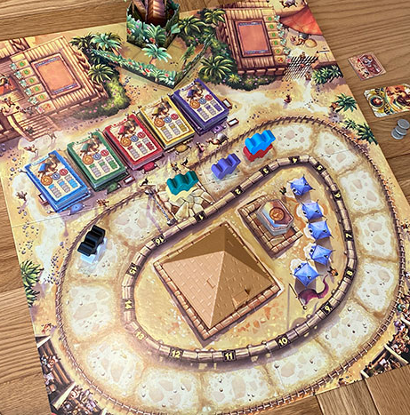
Work with a partner to finish implementing a Terminal-based Camel Up game.

Slide 3
How can we decompose this program into separate components?

Slide 4
Exercise 0: Decomposition
What are the rules of Camel Up?
What could be the main organizational entities of a digital version of the game?
What pieces of data does our program need to keep track of throughout the game?
  What type of data structures should we use for each? Why?

Slide 5
Data Needs for Camel Up
The board state -
Contains all the elements that comprise the “working memory” of a Camel Up game.
Betting Tickets (Leg Winner)
Each ticket has a color and a first place payout.
Tickets held by each player
Tickets left to be taken
Dice
Each die has a color (e.g. purple) and a number (1-3)
Dice left in the pyramid that can still be rolled on this leg
Dice that have already been rolled
Race Track
16 track positions
camels that currently on each track position
(order of camels matters)
Coins
The amount of money each player has won
Other Considerations:
Player Names
Spectator Tiles
Overall Winner/Loser Betting Tickets

Slide 6
Starter Code Game Rules
Simplified Starter Code Rules:
  Two players
  4 Betting Tickets per Camel: 5, 3, 2, 2
  Only two possible moves: Bet or Roll
    No Spectator Tickets in basic version
  1 leg of the race
Groups will extend these starter rules on Day 3.

Slide 7
Starter Code Reading Qs
What happens when you run the code?
What is the function of each of the three files?
How do we keep track of the camel positions? If the red camel is on top of the blue camel, how are they ordered in the data structure?
How do we keep track of which dice have/haven’t been rolled already?

Slide 8
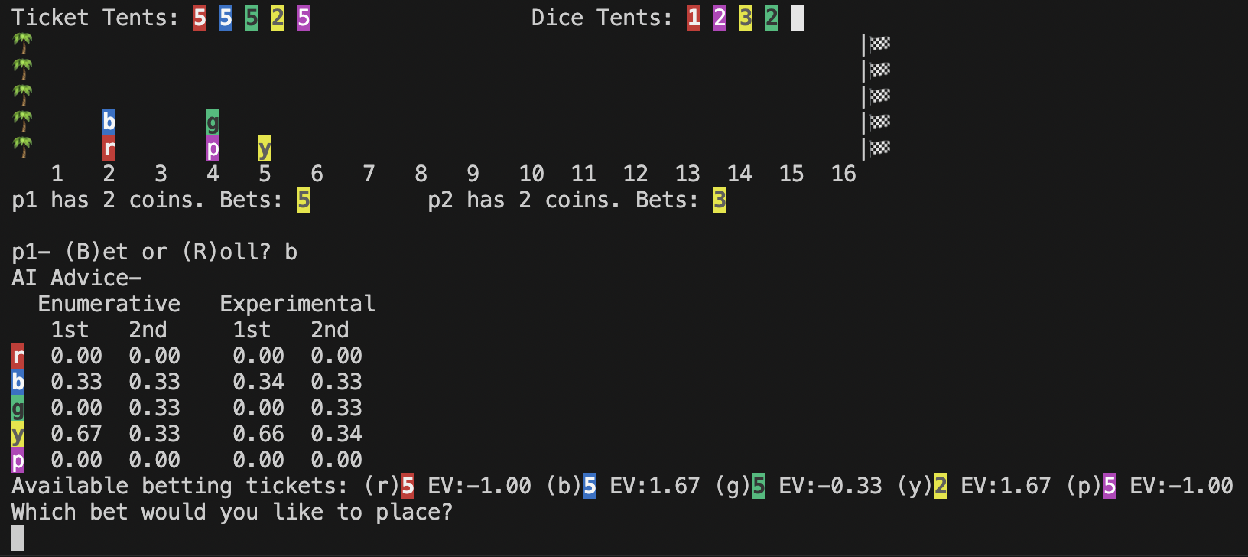
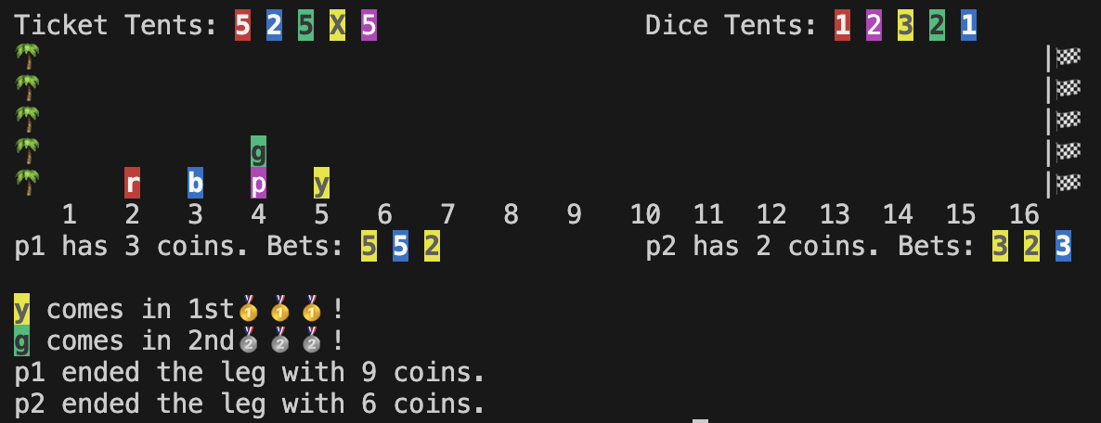
Our simplified Terminal-based Camel Up game:

Slide 9
CamelUpBoard
TRACK_POSITIONS: int DICE_VALUES: list BETTING_TICKET_VALUES: list camel_colors: dict[str, str] camel_styles: dict[str, str] track: list[list[str]] pyramid: set[str] ticket_tents: dict[str, list[int]] dice_tents: list[Die]
__init__() starting_positions():list[list[str]] print(list[CamelUpPlayer]) reset_tents() place_bet(color): Ticket move_camel(Die) shake_pyramid():Die is_leg_finished(): bool get_rankings(): tuple get_all_dice_roll_sequences:set run_enumerative_analysis run_experimental_analysis(int)
CamelUpGame
CAMEL_STYLES: dict[str, str] board: CamelUpBoard players: list[CamelUpPlayer]
__init__() get_player_move(CamelUpPlayer):str get_player_bet(CamelUpPlayer):str play_1_leg() leg_payouts_and_results() print_AI_advice() get_ticket_EV(int, float, float)
Ticket: (‘r’, 5)
Die: (‘r’, 1)
CamelUpPlayer
name: str tickets: list[tuple] money: int
__init__() win_money(int) pay_money(int) bet(Ticket) reset_tickets()
Starter Code: Camel Up Decomposition

Slide 10
Day 1 Exercises:
CamelUpBoard
TRACK_POSITIONS: int DICE_VALUES: list BETTING_TICKET_VALUES: list camel_colors: dict[str, str] camel_styles: dict[str, str] track: list[list[str]] pyramid: set[str] ticket_tents: dict[list] dice_tents: list[tuple]
__init__() starting_positions(): list[list[str]] print(players) reset_tents() place_bet(color): tuple move_camel(tuple[str, int]) shake_pyramid() is_leg_finished(): bool get_rankings(): tuple Get_all_dice_roll_sequences: set run_enumerative_analysis run_experimental_analysis(int)
Understand how the pieces of the game fit together.
Implement the following CamelUpBoard functions:
  move_camel
  shake_pyramid
  is_leg_finished
  get_rankings
  Improve starting_positions so that initial camel positions are random per usual game rules
Upload CamelUpBoard.py to the Camel Up: Day 1 - CamelUpBoard Basics Gradescope assignment

Slide 11
Day 2 Exercises:
CamelUpBoard
TRACK_POSITIONS: int DICE_VALUES: list BETTING_TICKET_VALUES: list camel_colors: dict[str, str] camel_styles: dict[str, str] track: list[list[str]] pyramid: set[str] ticket_tents: dict[list] dice_tents: list[tuple]
__init__() starting_positions(): list[list[str]] print(list[CamelUpPlayer]) reset_tents() place_bet(color): tuple move_camel(tuple[str, int]) shake_pyramid() is_leg_finished(): bool get_rankings(): tuple get_all_dice_roll_sequences: set run_enumerative_analysis run_experimental_analysis(int)
Implement the following CamelUpBoard functions
  get_all_dice_roll_sequences
  run_enumerative_analysis
  run_experimental_analysis
Implement the following CamelUpGame functions
  get_ticket_EV
Upload CamelUpBoard.py and CamelUpGame.py to the Camel Up: Day 2 - Probability Analysis Gradescope assignment

Slide 12
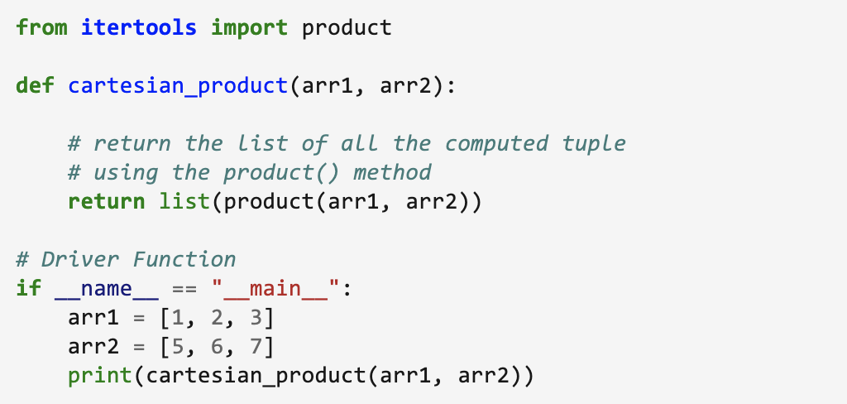
itertools: product
itertools.product() returns the cartesian product of iterables.
Output:
[(1, 5), (1, 6), (1, 7), (2, 5), (2, 6), (2, 7), (3, 5), (3, 6), (3, 7)]

Slide 13
copy vs deepcopy - deepcopy_demo.py
copy() helps avoid object aliasing
list1 = [1, 2, 3, 4, 5] list2 = list1 #list2 = list1.copy() list2[0] += 3 print(list2) #[4, 2, 3, 4, 5] print(list1) #[4, 2, 3, 4, 5]
copy() shares references to nested objects (Shallow copy)
list_of_lists1 = [[1], [2, 3], [4, 5]] list_of_lists2 = list_of_lists1.copy() list_of_lists2[0] = [300] list_of_lists2[1][0] = [888, 999] print(list_of_lists2) #[[300], [888, 999], [4, 5]] print(list_of_lists1) #[[1], [888, 999], [4, 5]]
deepcopy() protects references to nested objects (Deep copy)
from copy import deepcopy list_of_lists1 = [[1], [2, 3], [4, 5]] list_of_lists2 = deepcopy(list_of_lists1) list_of_lists2[0] = [300] list_of_lists2[1][0] = [888, 999] print(list_of_lists2) #[[300], [888, 999], [4, 5]] print(list_of_lists1) #[[1], [2, 3], [4, 5]]

Slide 14
Day 3 Exercises:
Implement at least one of these possible extensions for CamelUp:
Camel Emoji’s
  Replace letters with the camel emoji: 🐪 (which unfortunately only faces left)
  Reformat the board.print function to accommodate the direction shift (ie. camels move left)
Full Game
  Allow players to play multiple legs of the race until the first camel has crossed the finish line
Spectator Cards
  Add an additional move option: Press (S) to place a spectator card
  Update UI
  Update probability analysis functions
Betting on winner/loser of game
  Allow an additional move: Press (W) or (L) to bet on the winner or loser of the game
  Assign the appropriate game rewards at the end of the game (see game instructions)

